Slide 1
EE-277A EMBEDDED SOC DESIGN
TIC-TAC-TOE
IMPLEMENTATION
ON
CORTEX-M0
Group Members :
Vishwajeetsinh Varnamiya
Sai Kashyap Kurella
Zeel Jatinkumar Lia

Slide 2
Agenda
Introduction
Cortex M0 Overview
Game Rules
Proposed Game Design
Implementation
Code Level Implementation
Future work
Conclusion

Slide 3
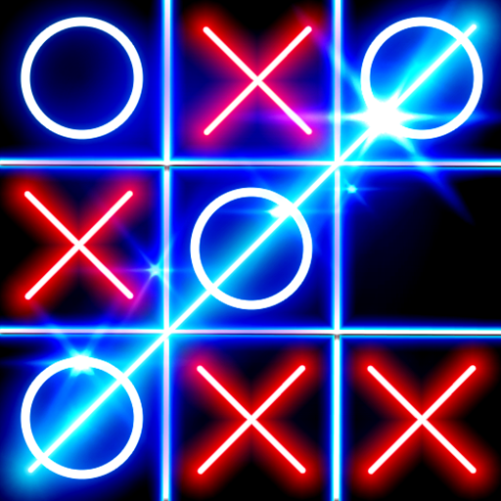
INTRODUCTION
Tic-Tac-Toe also knowns as Noughts and Crosses.
It is a typical two-player game.
The game is typically played with Xs and Os.(we planned to use
Two variants of colors instead)

Slide 4
CORTEX M0 OVERVIEW
It is a 32-bit Microcontroller that is a part of Cortex-M series designed by ARM Holdings.
It supports communication protocol like UART, SPI and I2C.
It also features low power sleep mode.

Slide 5
GAME RULES
Tic-Tac-Toe is played on a three-by-three grid, with two players taking turns to place their respective marks (X or O) on an empty cell.
The first player to get three of their marks in a row, either horizontally, vertically, or diagonally, wins the game.
The game starts with an empty grid, and the first player places their mark on any empty cell.
Players must take turns to place their mark and cannot occupy a cell that has already been marked

Slide 6
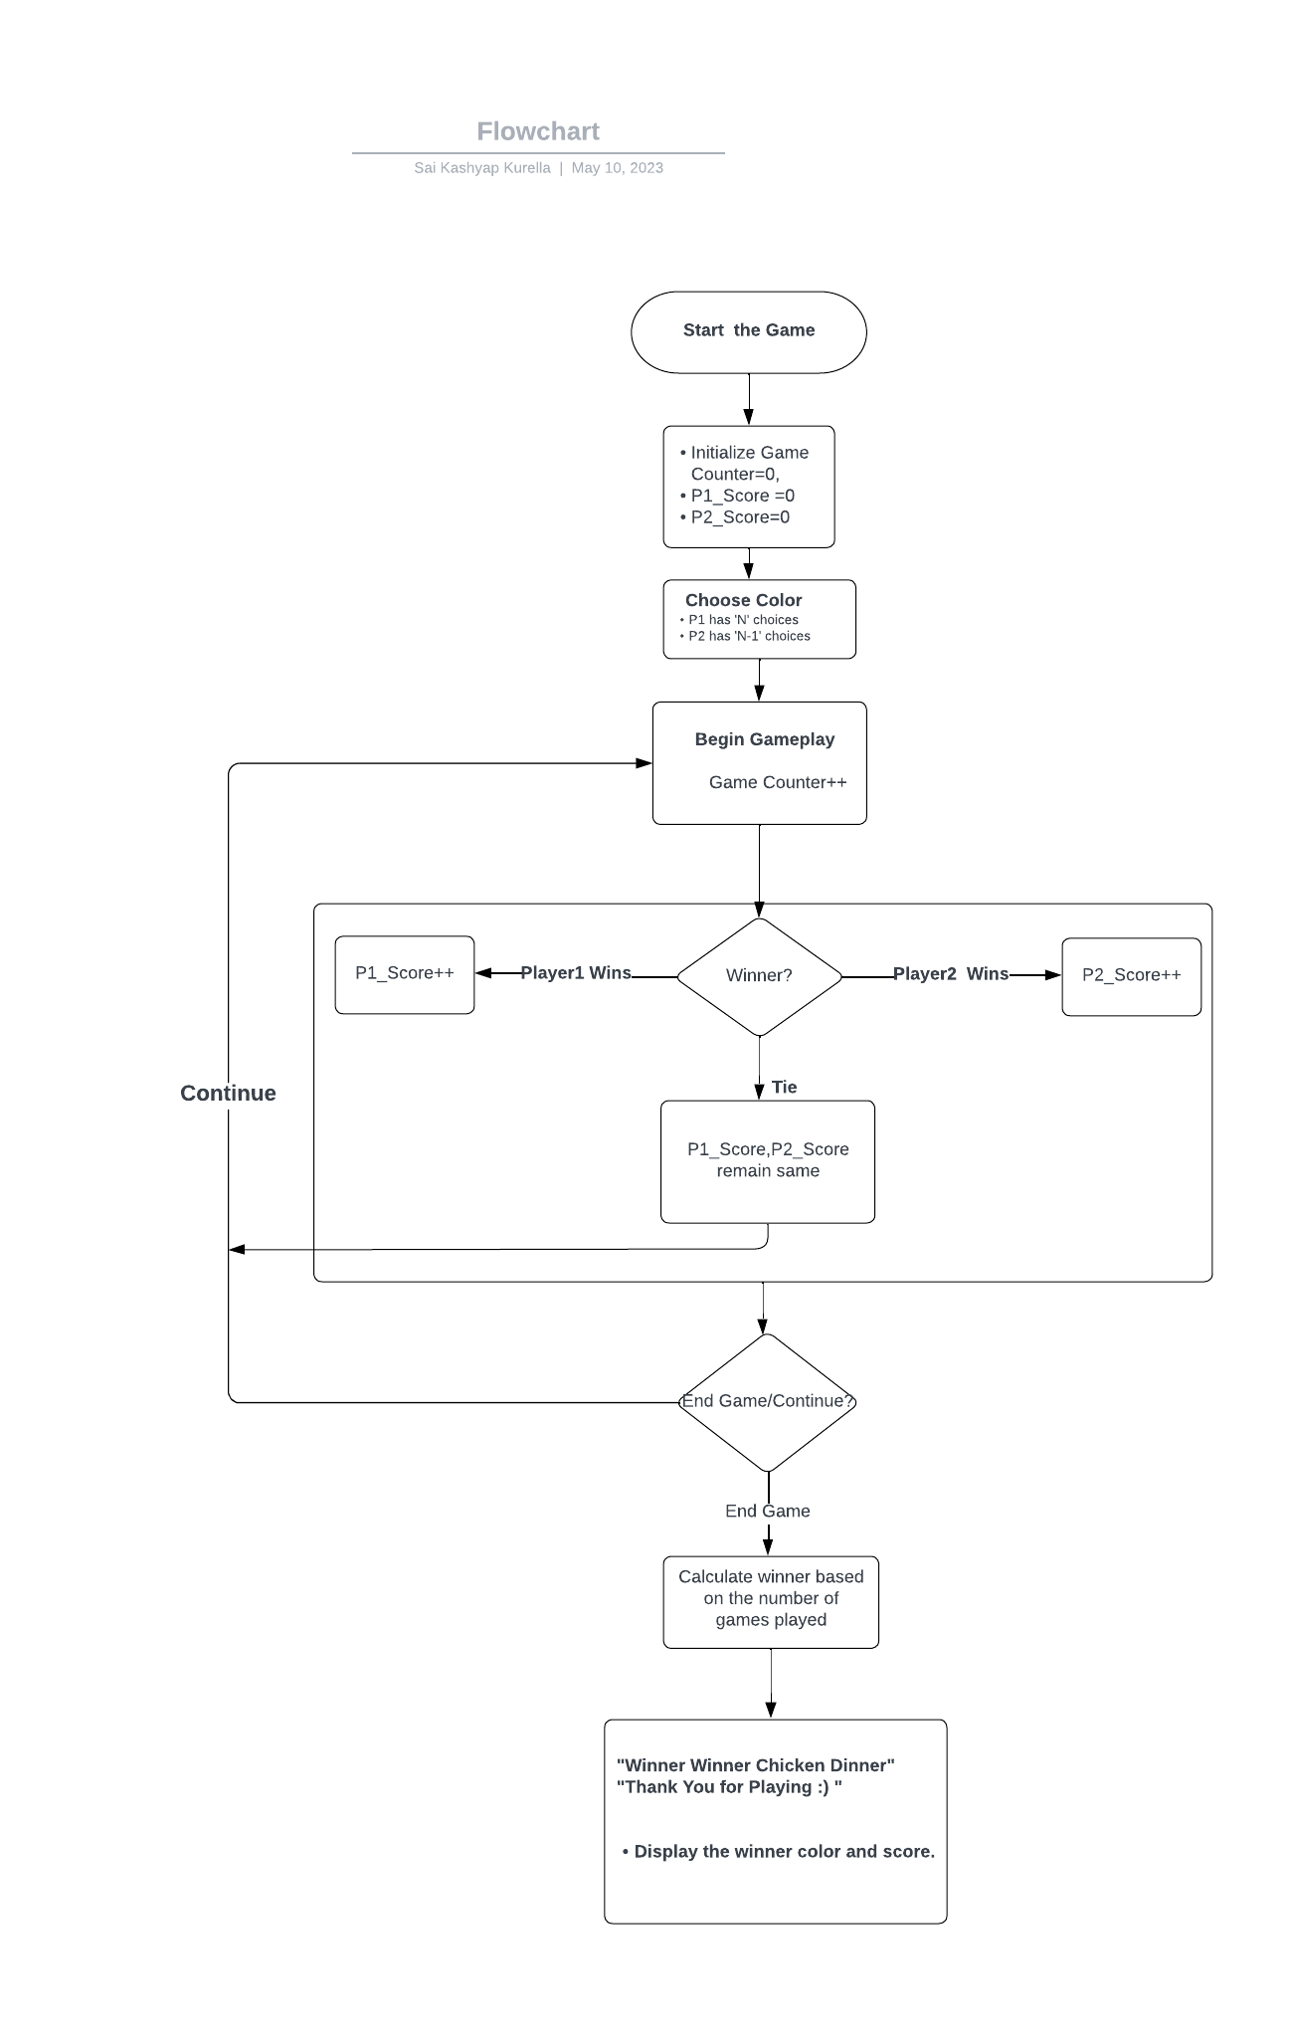
PROPOSED GAME DESIGN

Slide 7
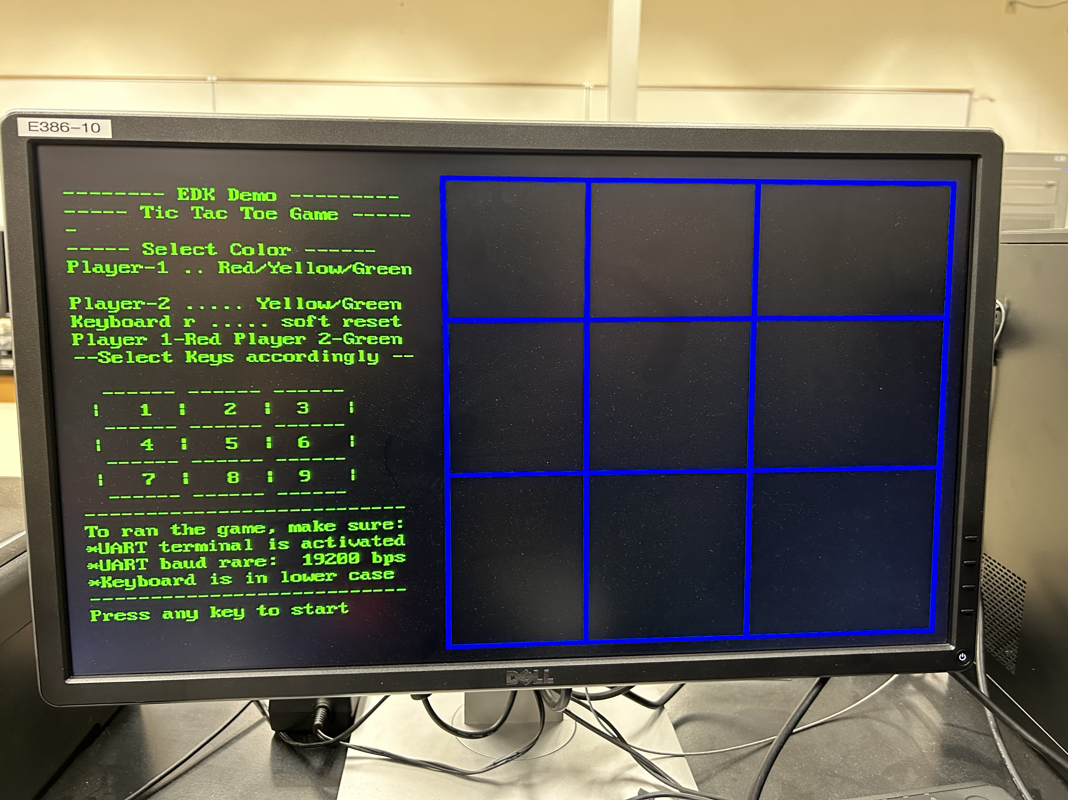
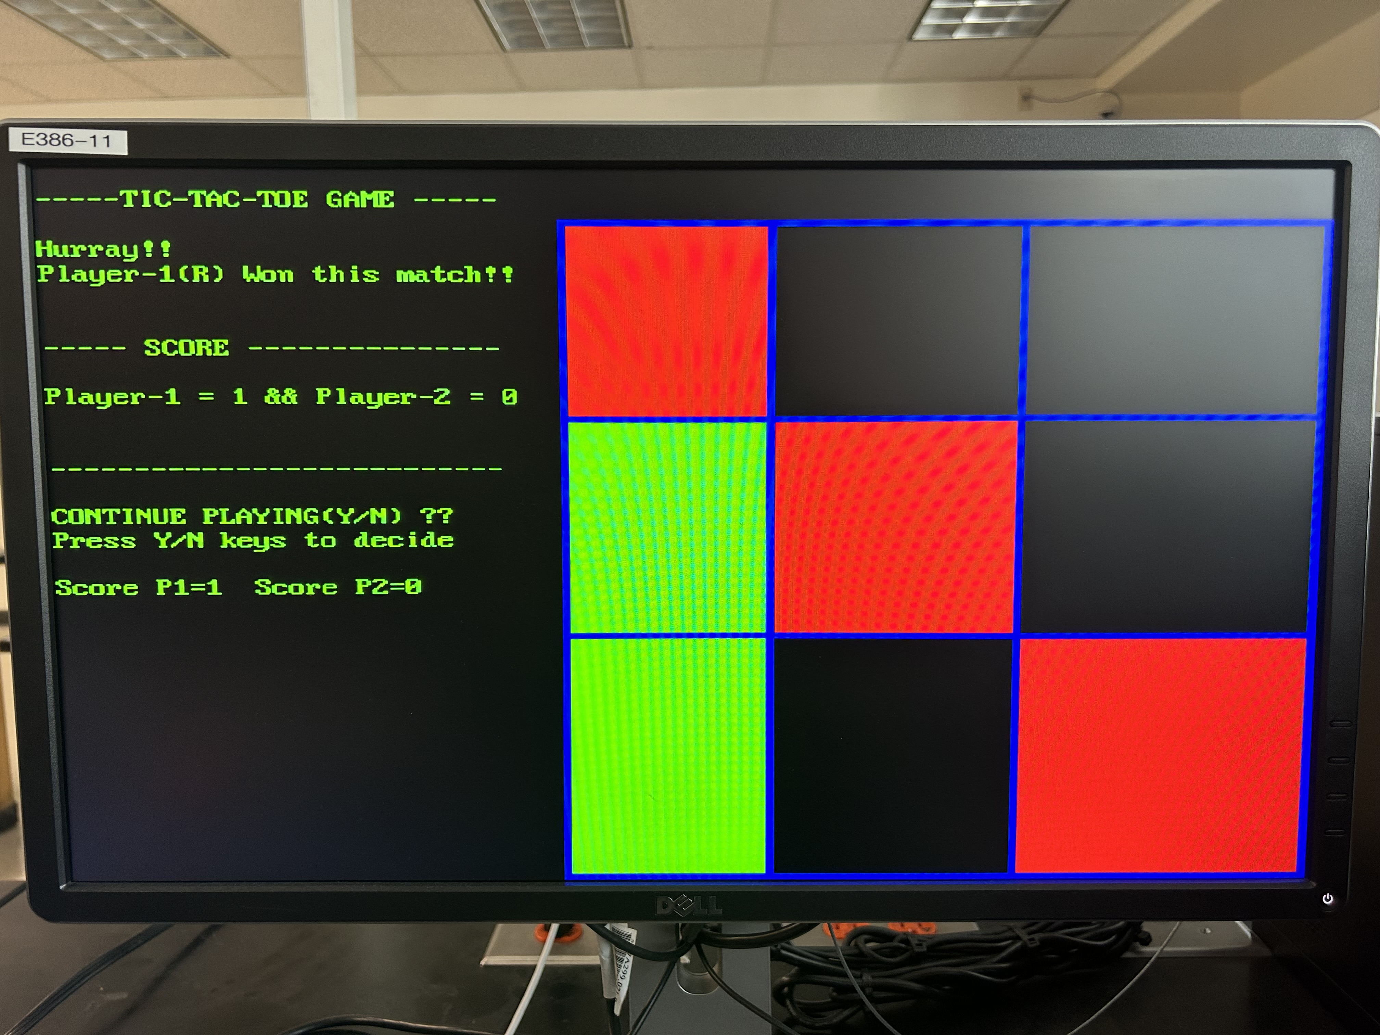
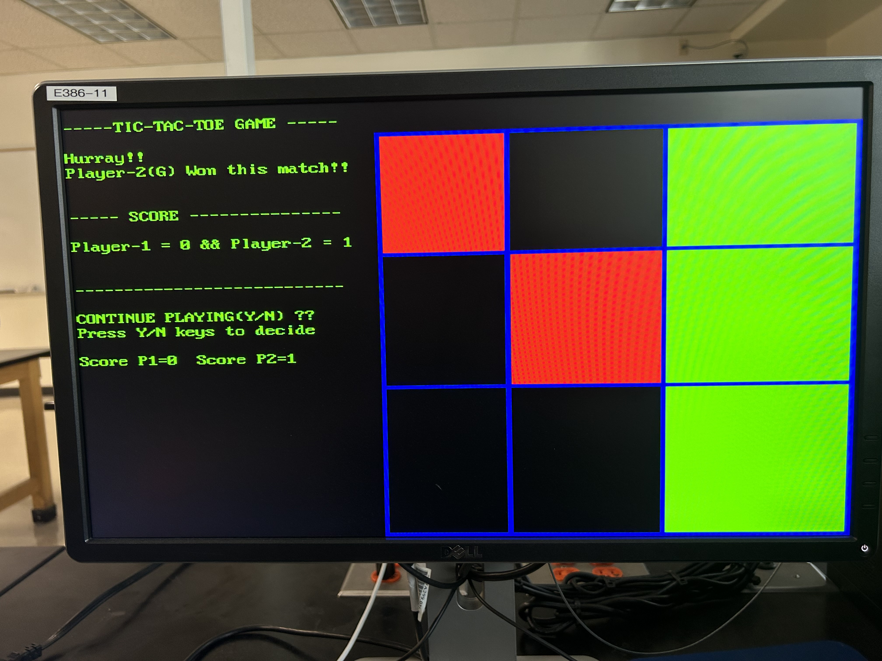
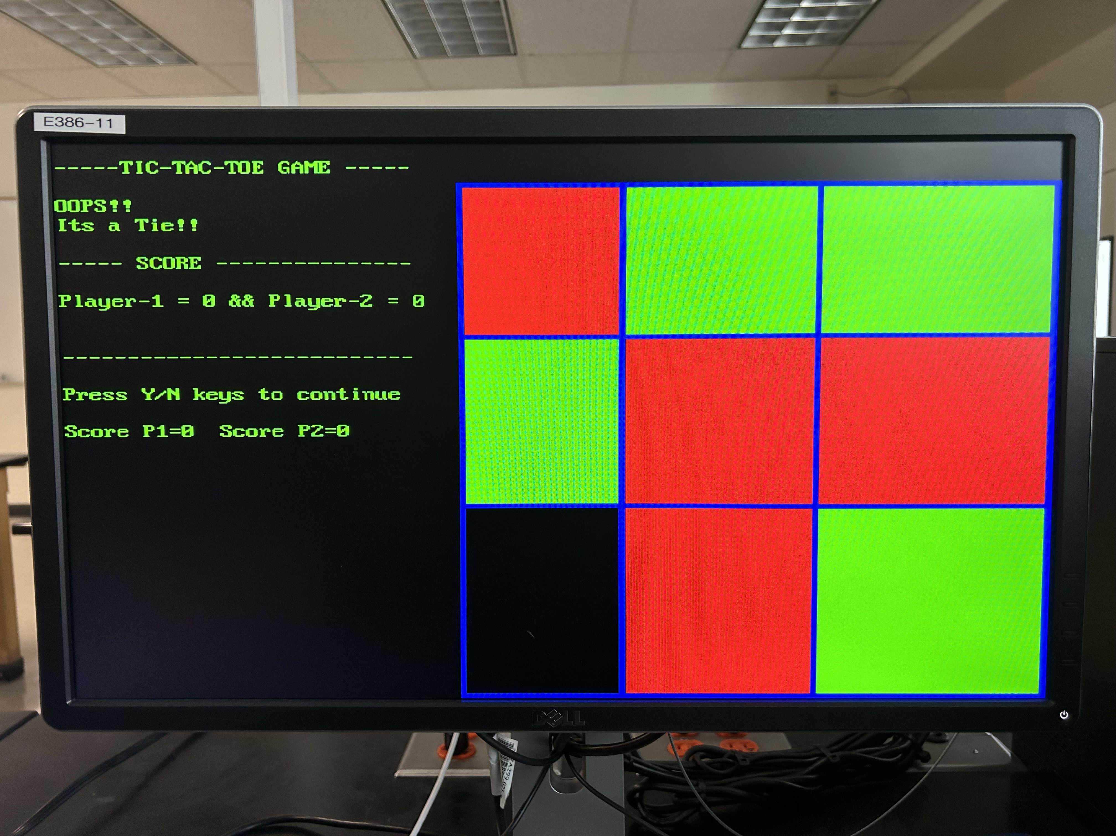
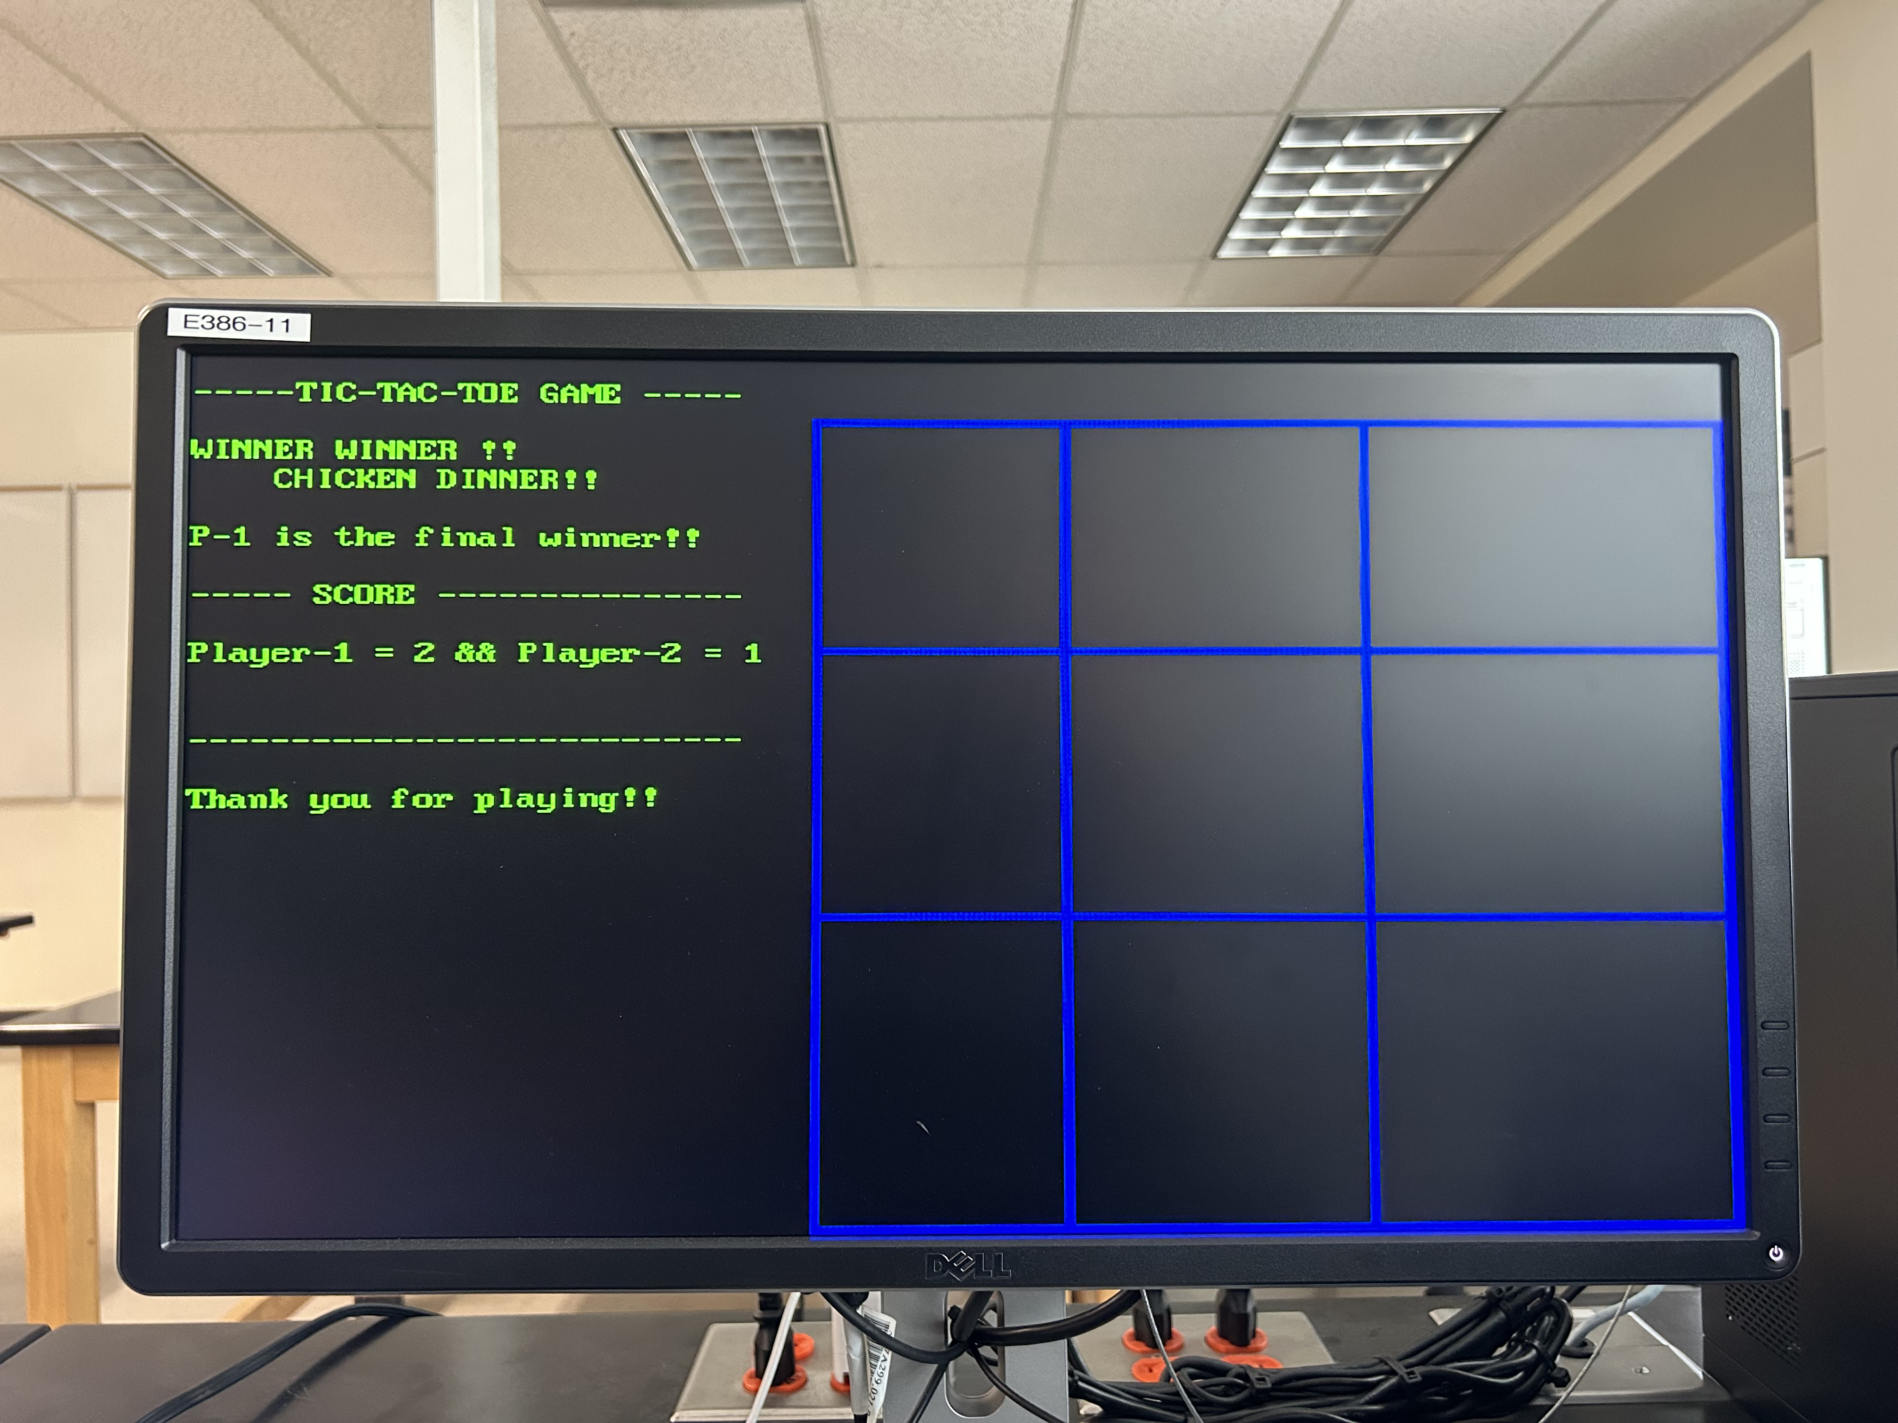
IMPLEMENTATION OVERVIEW
CONTIUE??
(Y/N)

Slide 8
IMPLEMENTATION -START

Slide 9
IMPLEMENTATION (PLAYER-1 WINS)

Slide 10
IMPLEMENTATION (PLAYER-2 WINS)

Slide 11
IMPLEMENTATION (TIE)

Slide 12
Final Result Display

Slide 13
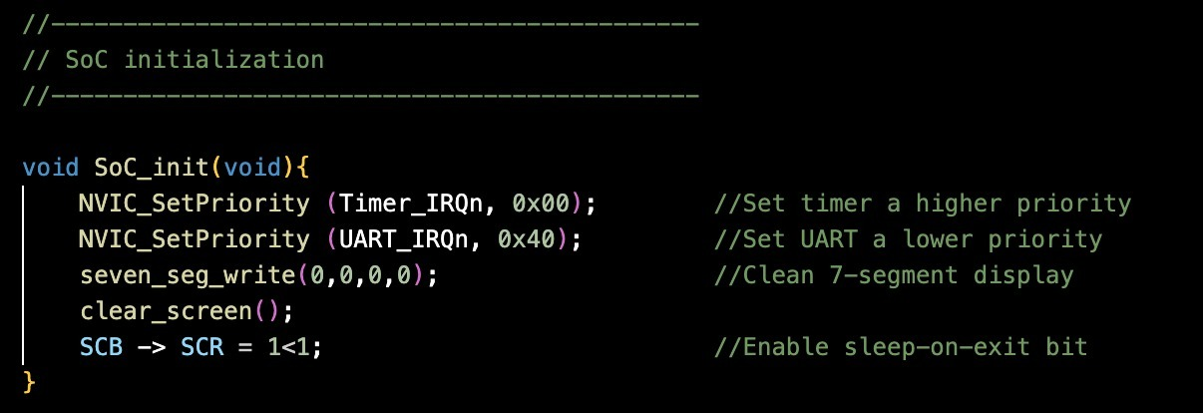
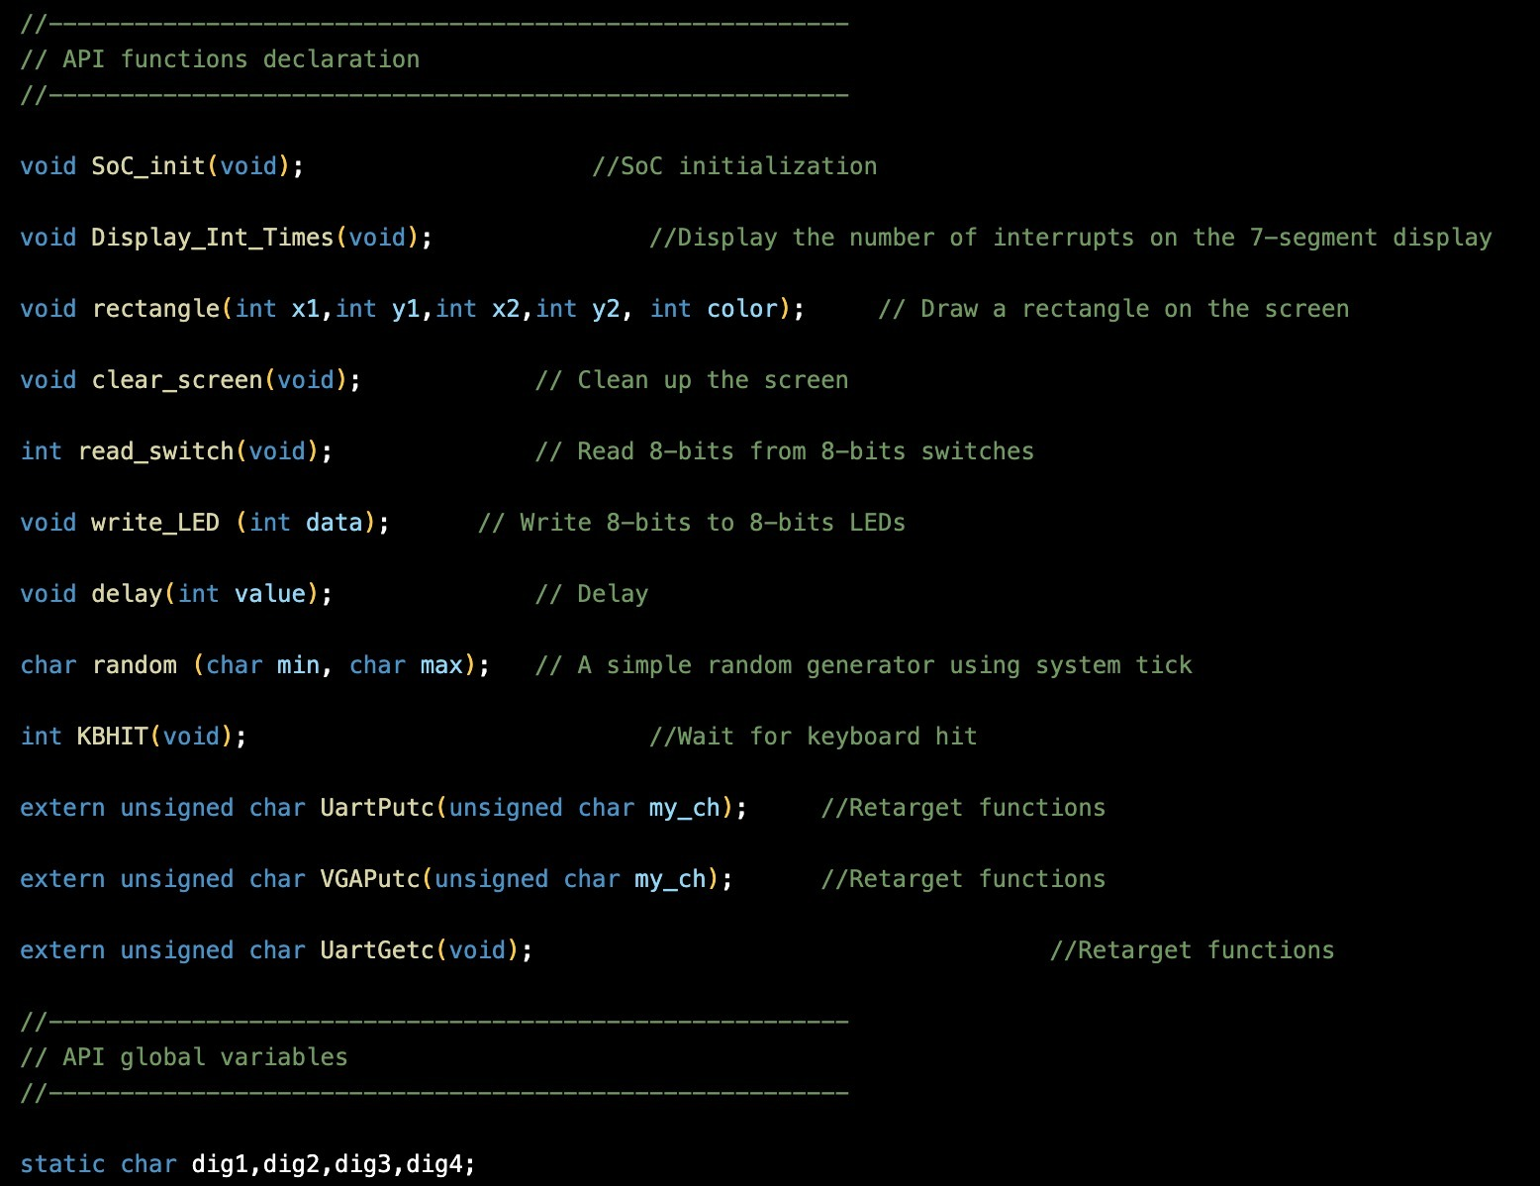
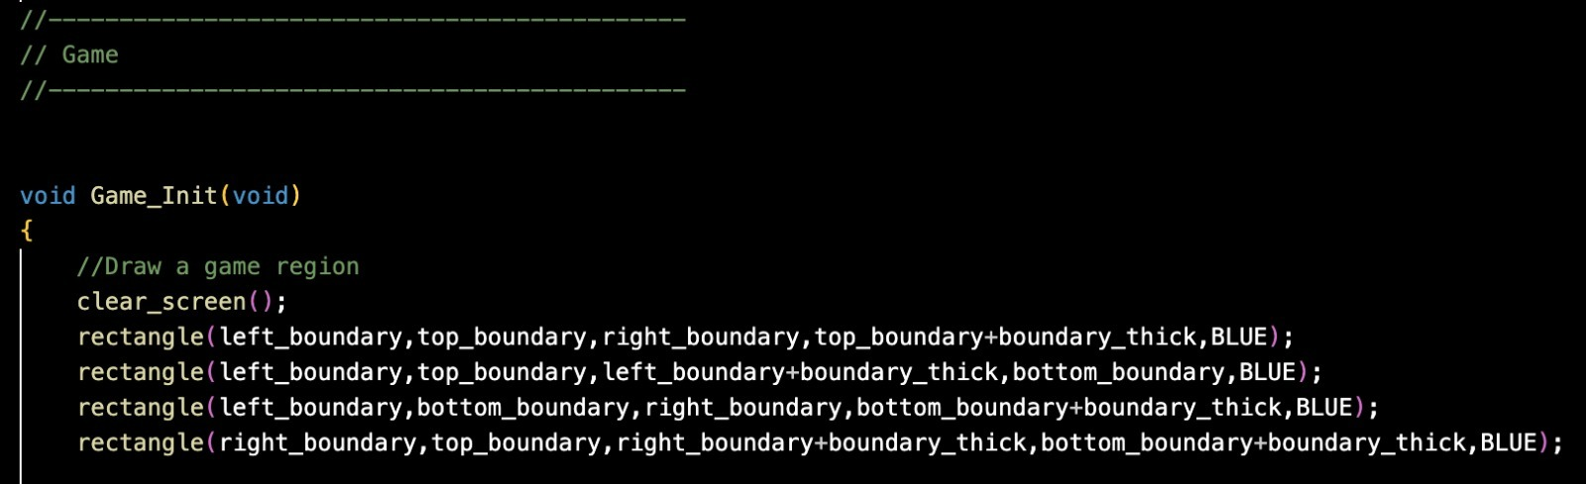
CODE LEVEL IMPLEMENTATION

Slide 14
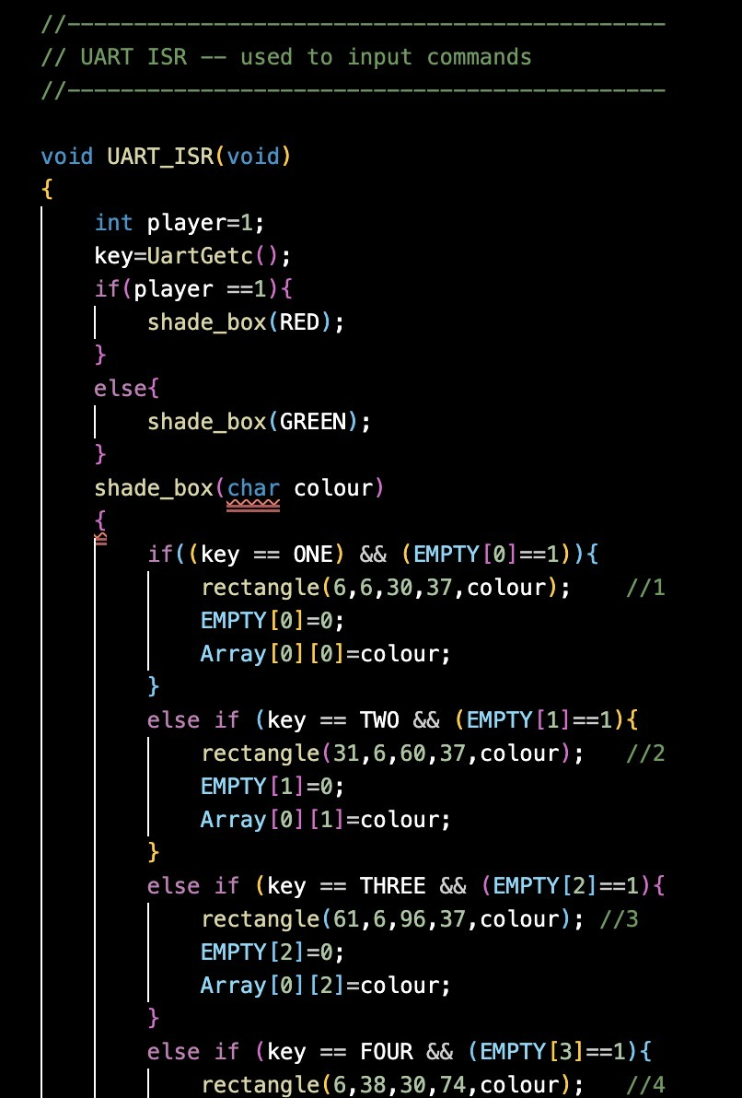
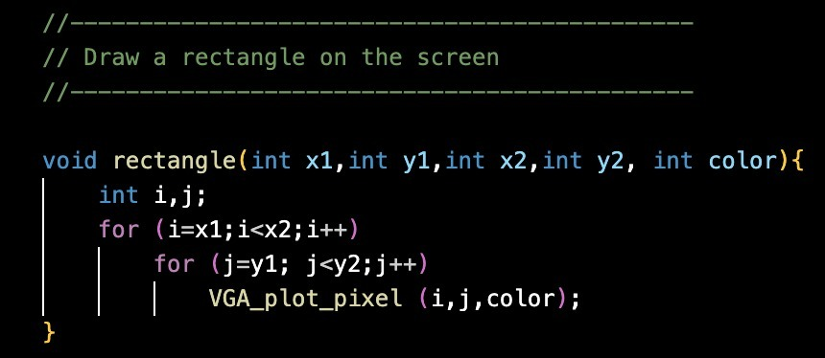
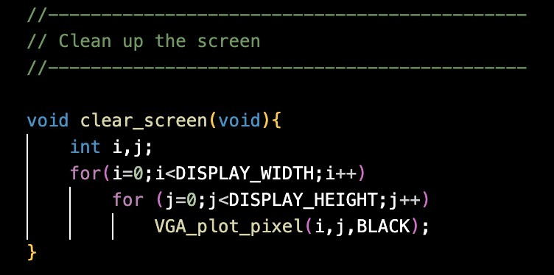
CODE LEVEL IMPLEMENTATION

Slide 15
FUTURE WORK
Implement multiple color selection mechanism.
Adjust blocks(squares) equal sized.
Implement multiple match mode.
Implement accurate result displaying functionality for multiple matches played.
Improve the text format in the text region.

Slide 16
CONCLUSION
So far, we have implemented the basic game design which allows us to play the game only one-time and forces us to restart the FPGA for every new game.
However, we are working on implementing the modifications and all other pending features mentioned in the future works.

Slide 17
THANK YOU!!

